Slide 1
Project Discussion
28th February 2025

Slide 2
Phase | Date Range | Detailed Tasks | Status
1. Data Annotation & Setup (Completed) | Pre-March 1 | Annotate all chart elements (X & Y Axes, ticks, axis titles, data point labels, legends, plotting areas) | 2
 |  | Prepare and organize the dataset for training (include varied examples for Pie, Bar, and Line charts) | 2
2. YOLO Training (Completed) | Pre-March 1 | Train YOLO to detect annotated chart elements | 2
 |  | Validate YOLO performance on diverse chart samples | 2
 |  | Adjust training parameters based on early results | 2
3. Initial Axis Recognition Model (Completed) | Pre-March 1 | Develop a rough model for identifying axis elements (ticks, axis titles, etc.) | 2
 |  | Generate initial mappings between detected ticks and axis labels | 2
4. OCR Integration using PaddleOCR | March 1 – March 7 | Set up the PaddleOCR environment and install dependencies | 1
 |  | Crop out detected chart elements (from YOLO output) for OCR processing | 1
 |  | Run PaddleOCR on these cropped images to extract text and numbers
 |  | Validate OCR outputs and refine image preprocessing (resizing, contrast adjustments, etc.)

Slide 3
YOLO Training
Successfully annotated 1,800 charts for training.
After thorough research, we determined that SGD (Stochastic Gradient Descent) is the best optimizer for our case, as it performs well on image-based tasks.
Utilized Hyperparameter Optimization (HPO) on a subset of 300 charts to fine-tune the ideal SGD parameters.
Once optimal parameters were found, we trained our YOLO model for 100 epochs, ensuring robust learning and performance.

Slide 4
YOLO Training Output
Metric | Value | Inference
Precision (B) | 0.9724 (~97.24%) | Model correctly classifies positive samples with high accuracy, but may have some false positives.
Recall (B) | 0.9898 (~98.98%) | Model detects almost all true positives, meaning very few false negatives.
mAP@50 (B) | 0.9879 (~98.79%) | High mean Average Precision at 50% IoU, indicating strong object detection performance.
mAP@50-95 (B) | 0.7912 (~79.12%) | Performance across different IoU thresholds drops but is still strong. Lower values at higher IoUs may suggest room for improvement in tight bounding box precision.
Fitness | 0.8108 (~81.08%) | A general metric balancing precision, recall, and mAP. Indicates a well-trained model, but potential for further fine-tuning.

Slide 5
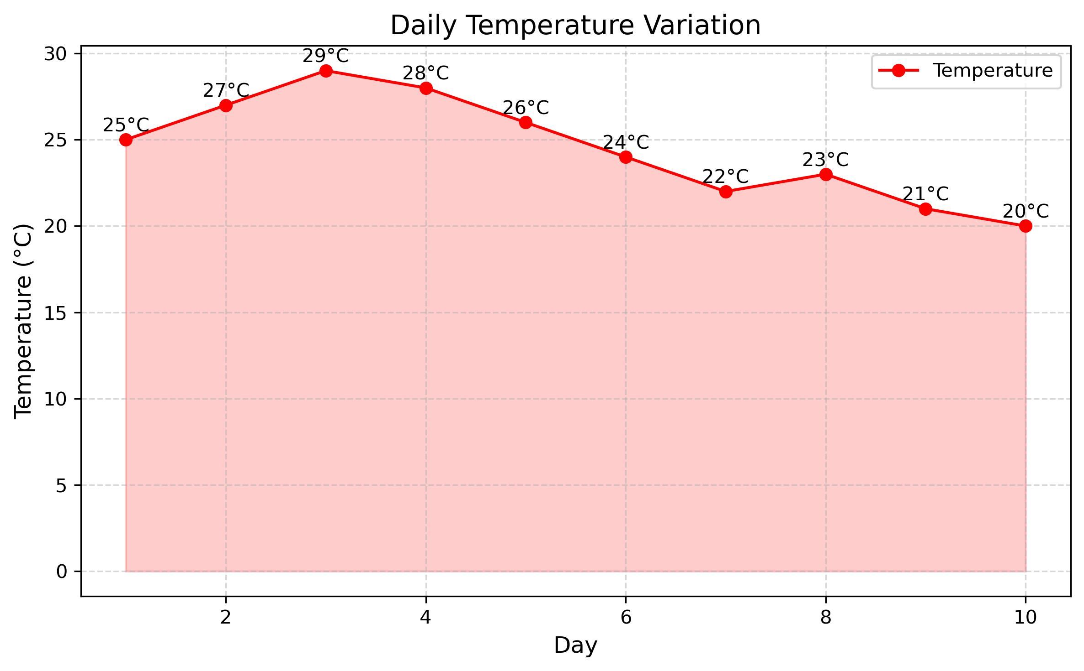

Slide 6
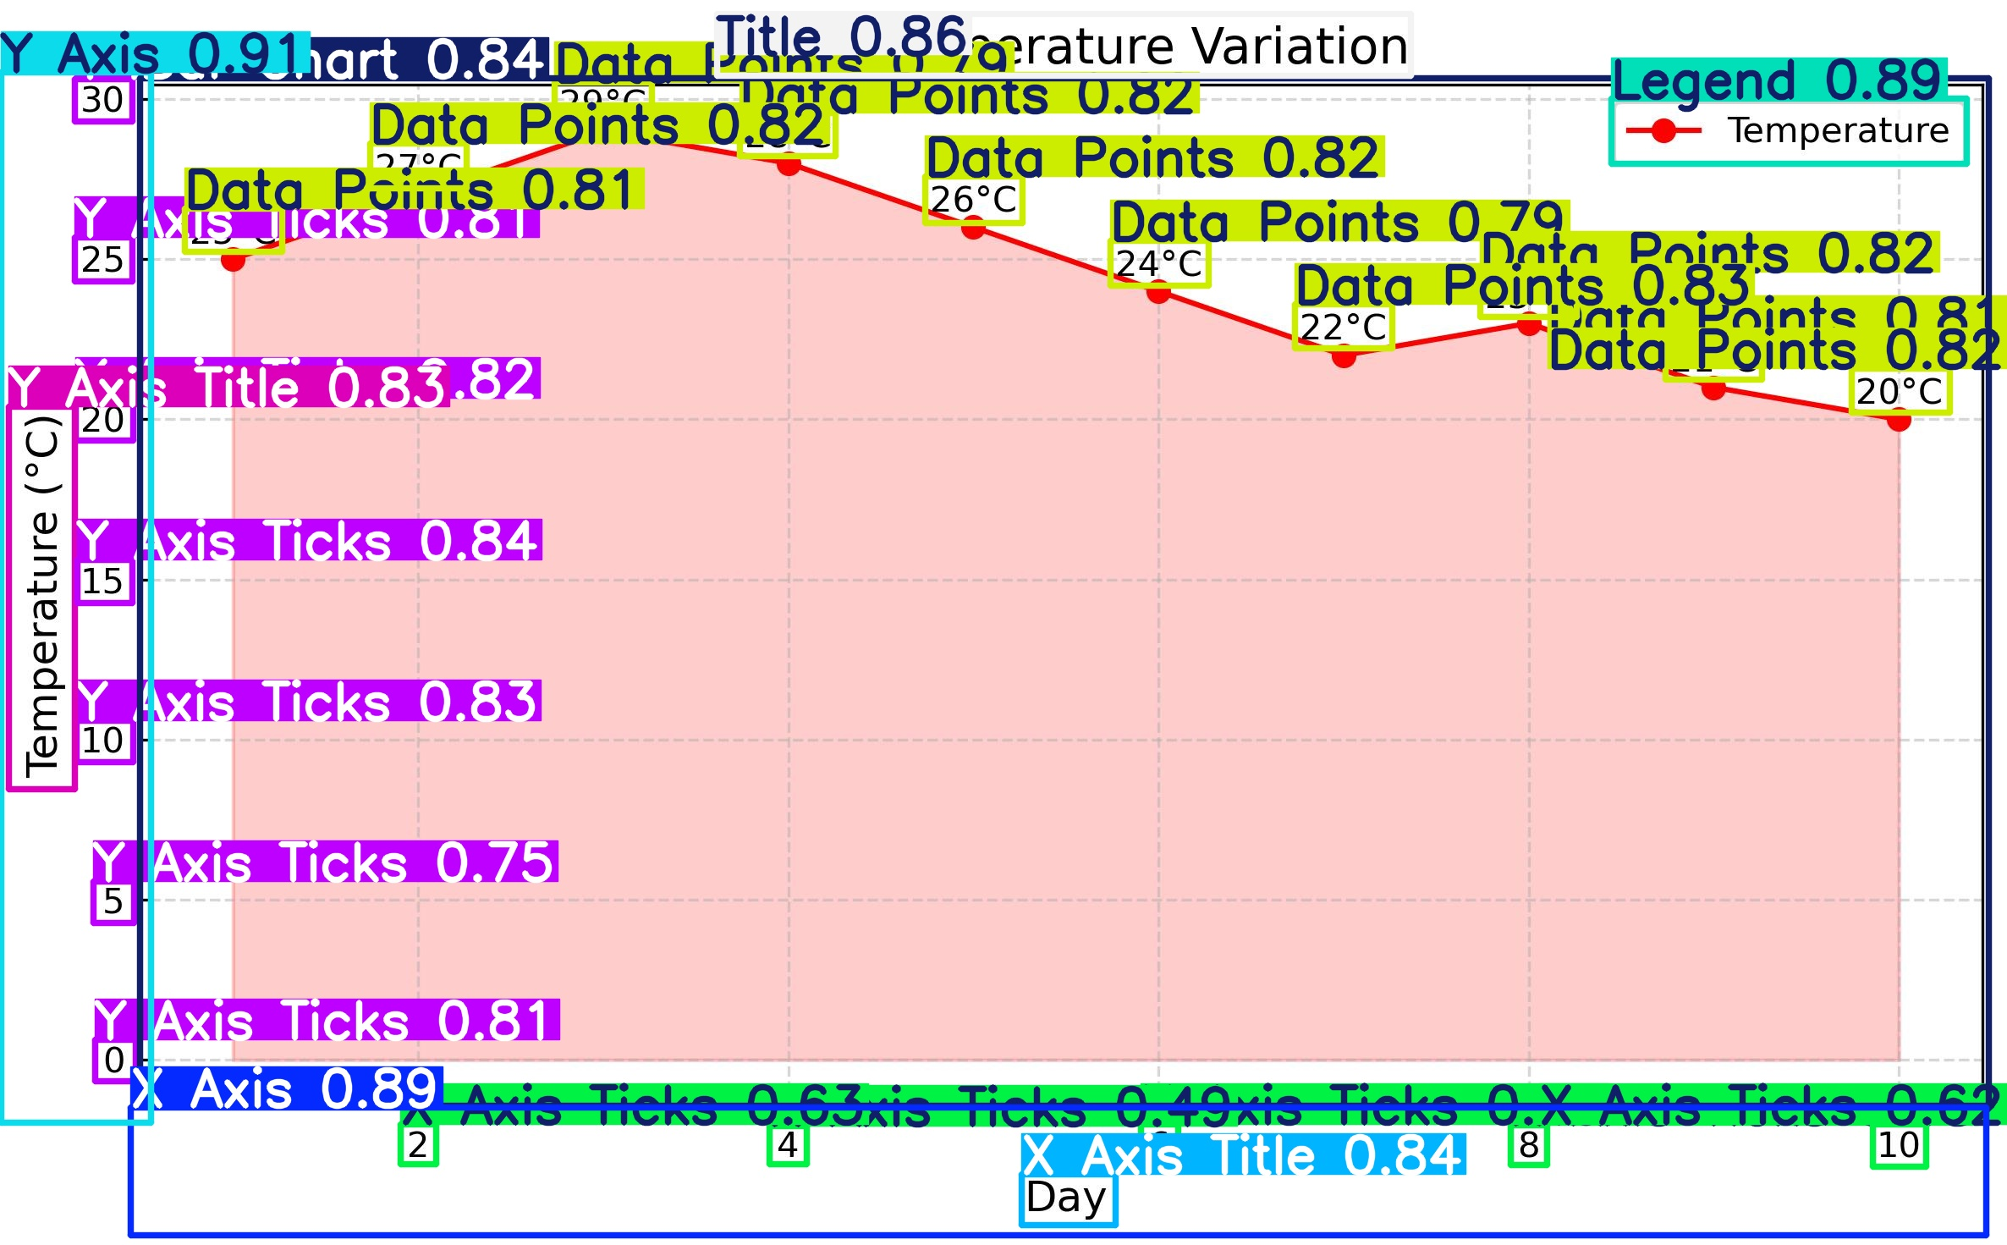

Slide 7
YOLO Output
{'coordinates': [1.6627793312072754, 85.07156372070312, 178.31922912597656, 1326.9884033203125], 'confidence': 0.9126198291778564, 'class': 1, 'label': 'Y Axis'}
“coordinates”: [x_min, y_min, x_max, y_max]

Slide 8
Why Use OCR?
Since YOLO only detects objects (not text content), OCR is needed to recognize and extract actual text from detected bounding boxes.
OCR can extract text from scanned documents, receipts, charts, and tables, which is difficult for traditional parsing methods.
OCR works with printed, handwritten, rotated, and stylized text, unlike template-based approaches.
Advanced OCR models (like PaddleOCR) can denoise, segment, and correct distorted text, making it better than simple image-to-text techniques.
OCR automates extraction, making it efficient for large-scale document processing.

Slide 9
Which OCR to use?
Feature | PaddleOCR (Best Choice) | EasyOCR (Good Alternative) | Tesseract (Basic & Outdated)
Accuracy (Text & Numbers) | High (Best for structured text & digits) | Moderate (Struggles with numbers) | Low (Good only for printed text, fails on complex layouts)
Speed | Fast (GPU acceleration available) | Fast (PyTorch-based, slightly faster than PaddleOCR) | Slow (CPU-based, struggles with large documents)
Handwritten Text Recognition | Supports, but not perfect | Limited support | Poor handwriting recognition
Rotated & Angled Text | Detects and corrects angles automatically | Struggles with rotated text | Fails on rotated text
Dense/Overlapping Text | Better handling for tables, invoices, receipts | ❌ Struggles with close characters | Fails on overlapping text
Table Extraction Support | Works well with structured data | No dedicated table detection | Requires post-processing
Custom Training Support | Easily trainable on custom data | No fine-tuning support | No deep learning-based training
GPU Acceleration | Supports GPU (TensorRT, Paddle Lite) | Supports GPU (PyTorch-based) | CPU only (Slow for large images)
Best Use Case | Invoices, ID cards, receipts, tabular data | Fast OCR for general text | Basic OCR for printed text only
We should go for PaddleOCR outperforms other OCR tools with superior accuracy for structured data, numbers, and overlapping text. It supports GPU acceleration, multi-language text, and robust table extraction, making it ideal for real-world document processing.

Slide 10
Current Progress
Annotations – Completed
YOLO Training – Completed
Rough Axis Recognition Model Building - Completed

Slide 11
Next Steps
OCR using PaddleOCR
Completing the Axis Recognition Model
Mapping the Data Points with the Axis
Creating a Table out of the Annotations, OCR, Axis Recognition Model, and Data Point Mapping
Build the whole pipeline from Annotation to Table Creation
Start on Text Generation and Summarization
Build a Roadmap

Slide 12
Minutes of Meeting

